Slide 1
Double the Carbs, Double the Fun, Double the Fuel

Slide 2



Vintage Cars MPG Predictor
Rice University Data Analytics & Visualization Boot Camp
Jessica Pardo
Dana Woodruff
Alex Jones

Slide 3
Agenda
Motivation
Data Cleaning and Modeling
Demo
Limitations and Future Work
Conclusions

Slide 4
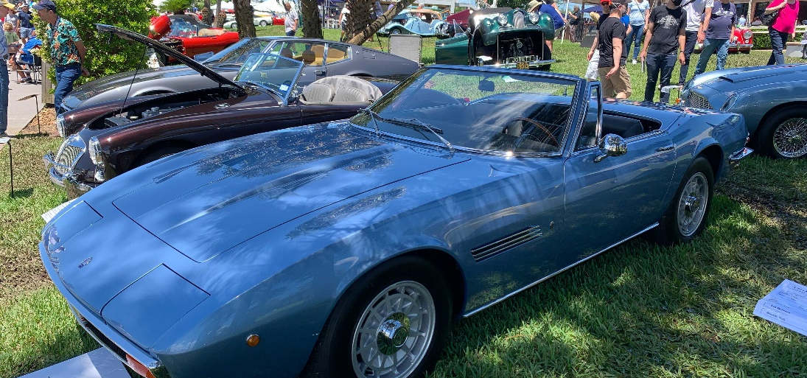
Motivation
Year 1970
As 1970 dawned the world’s cars averaged 149 horsepower and 17 miles per gallon… gas was cheap and the roar of the engines drowned out Elvis Presley and Creedence Clearwater Revival on the radio… Relatively low gasoline prices allowed consumers to focus on vehicle prices, performance, comfort, and style rather than efficiency.
Year 1973+
October 1973 brought the Yom-Kippur War. Early in the war, the U.S supplied Israel with arms, angering the Arab delegation of OPEC, which responded with an embargo of oil sales to the U.S. and other industrial centers. And so began the decade’s first oil crisis that sent oil prices skyrocketing upwards and auto manufacturers scrambling to offer more fuel efficient cars.
Machine Learning models will predict the gas mileage you’ll experience with your “new” vintage beauty.

Slide 5
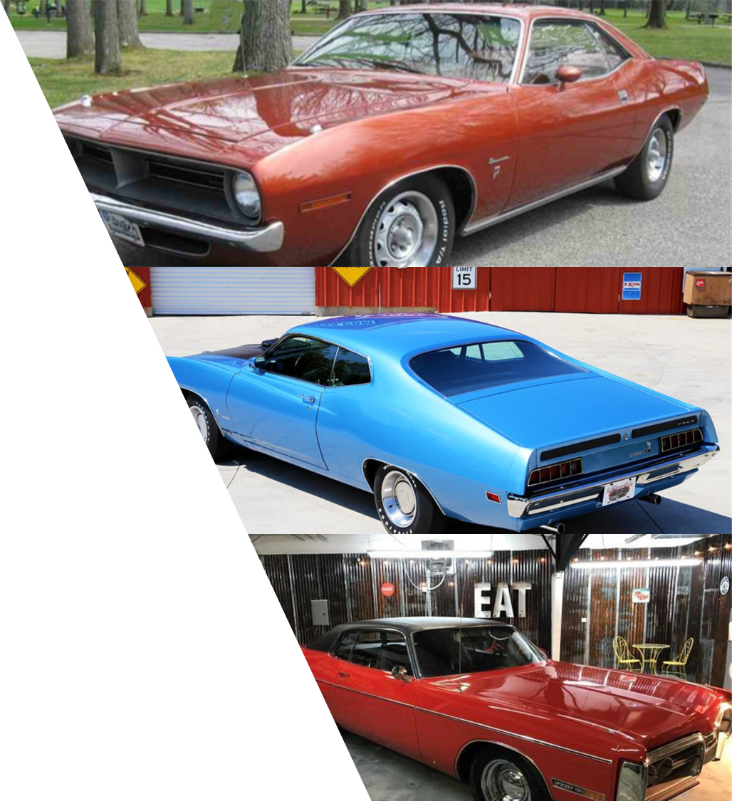
Data Cleaning and Modeling
Data
CSV Data sourced from Kaggle .
Data Cleaning
The original data .csv file is relatively clean with approximately 400 records and minimal cleaning required. Six null values in "horsepower" field were replaced with median values for modeling purpose.
Modeling
Machine Learning Regression models were carried out in order to predict MPG ( Miles per Gallon).

Slide 6
Demo
https://vintagecarsmpg.herokuapp.com/

Slide 7
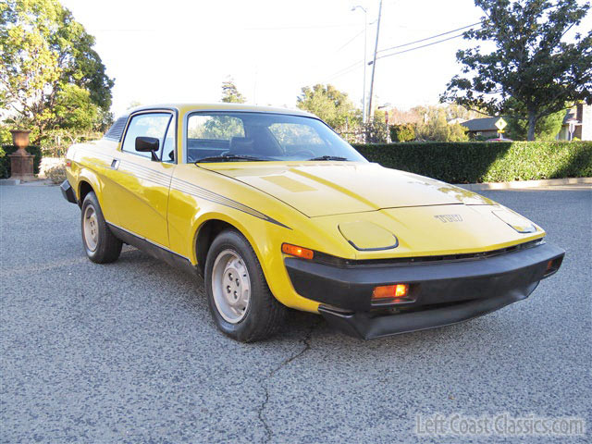
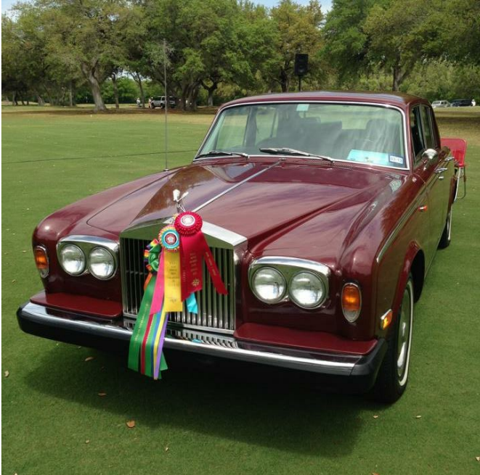
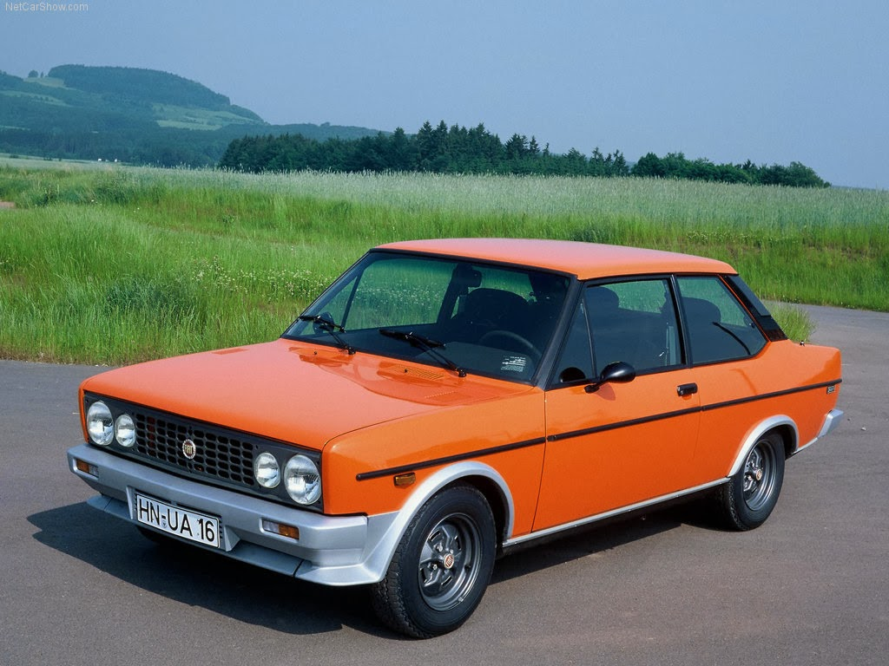
Limitations
While the dataset is very accurate, the size/completeness of the dataset did not allow the generation of more complex models.
Lack of balance between Euro and Asian cars in dataset.
Poor distribution of the data regarding the number of cylinders.

Slide 8

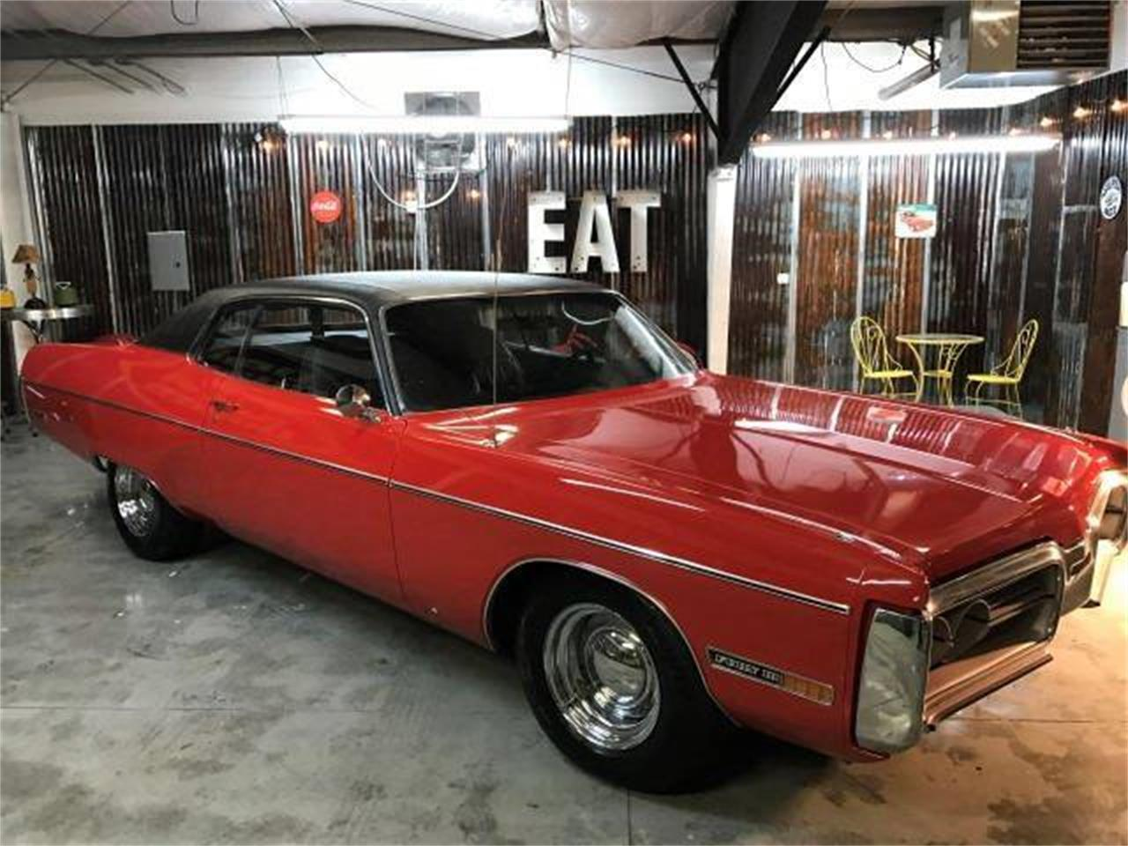
Future Work
Expand data set to include information from 1982 to present and more car data from 1970-1982.
Possibly get a license for auto catalog and access their database.
Perform other regression and classification models to improve predictions.
With an expanded data set we could show an animated time series chart.

Slide 9
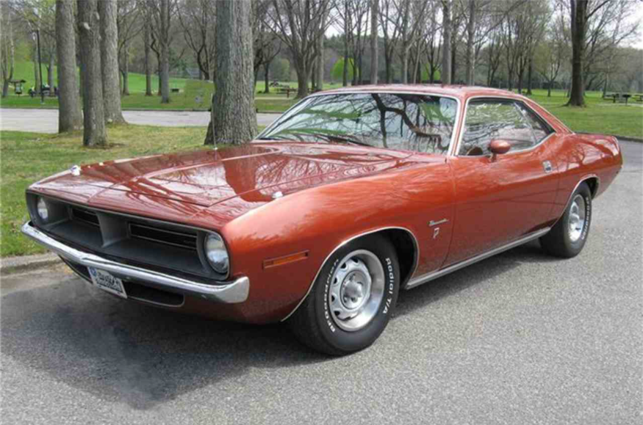
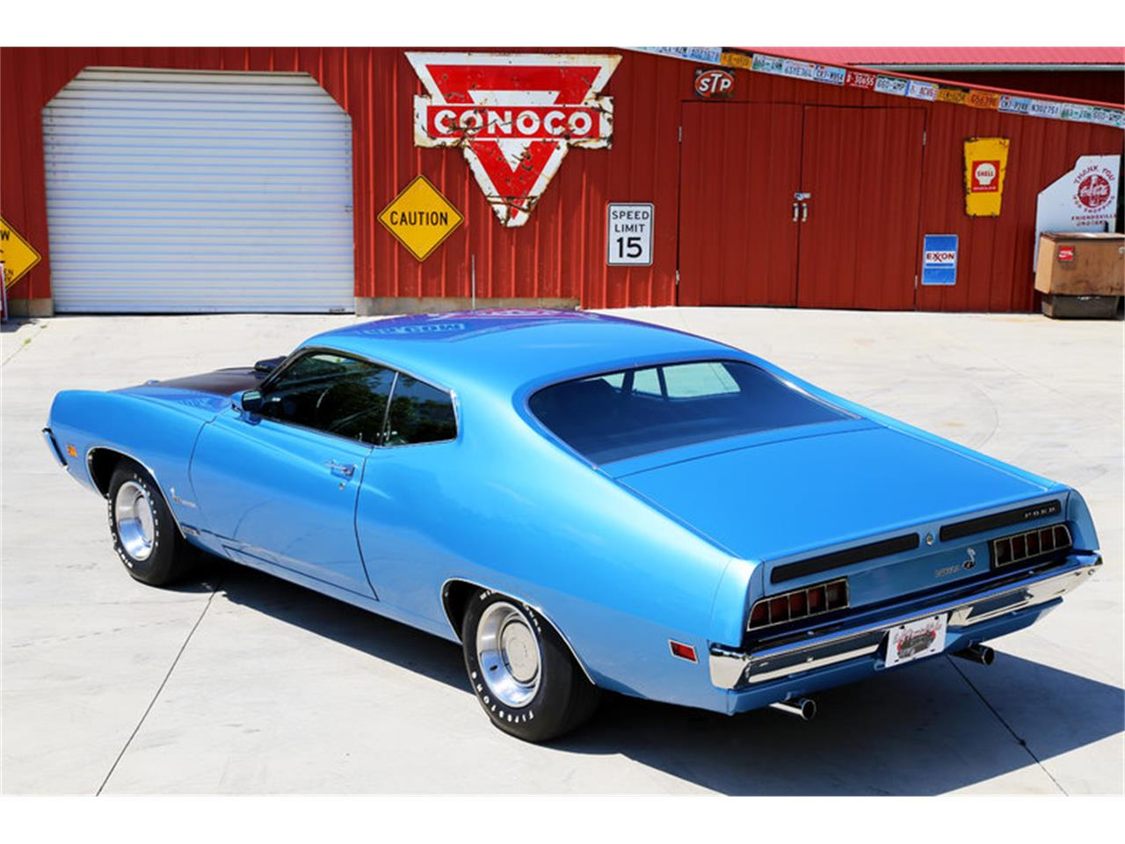
Conclusions
Between 1970 and 1982 fuel efficiency increased 88%, engine displacement went down 55%, car weight decreased 28% and horsepower decreased 45%.
Using our chosen predictive model there is a low margin of error when comparing the predictions to the actual specifications.

Slide 10


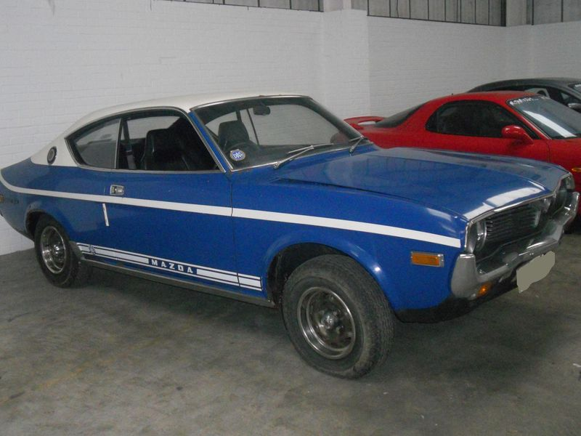
Questions?

